Slide 1

Electromagnetic Crosstalk: 3-conductor Line
Farhad Rachidi
Swiss Federal Institute of Technology (EPFL)
EMC Laboratory
Farhad.Rachidi@epfl.ch
http://emc.epfl.ch

Slide 2
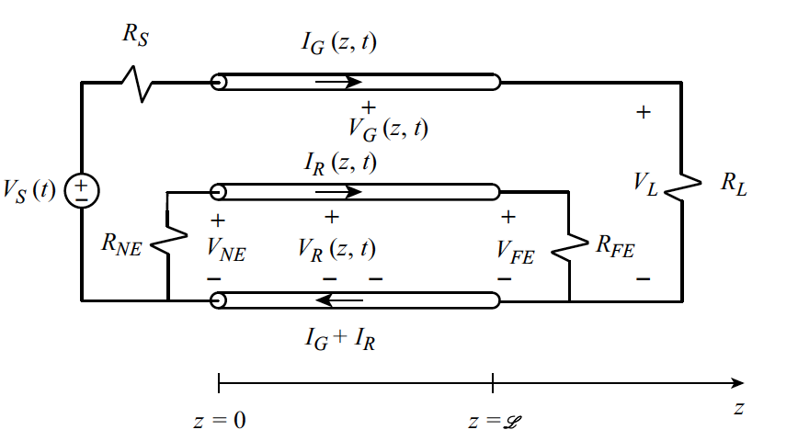
Crosstalk in Three-Conductor Transmission Line
Note that the line is along the z axis.

Slide 3
Crosstalk in Three-Conductor Transmission Line
We do not consider any external EM excitation

Slide 4
Crosstalk in Three-Conductor Transmission Line
Source
Resistance
Load
Resistance
Source
Voltage

Slide 5
Crosstalk in Three-Conductor Transmission Line
Generator
Conductor

Slide 6
Crosstalk in Three-Conductor Transmission Line
Receptor
Circuit

Slide 7
Crosstalk in Three-Conductor Transmission Line
Near-End
Resistance
Far-End
Resistance

Slide 8
Crosstalk in Three-Conductor Transmission Line
Reference
Conductor

Slide 9
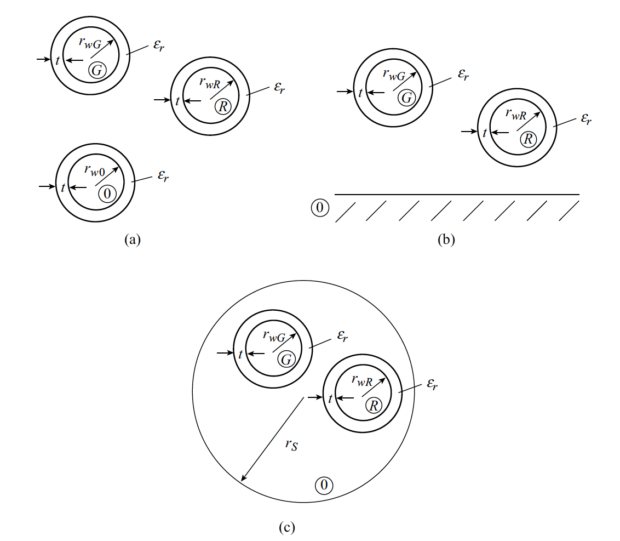
Cross Section of Typical Three-Conductor Transmission Lines Composed of Wires
Reference
Conductor
Reference Conductor:
Ground Plane
Reference Conductor:
Overall Shield

Slide 10
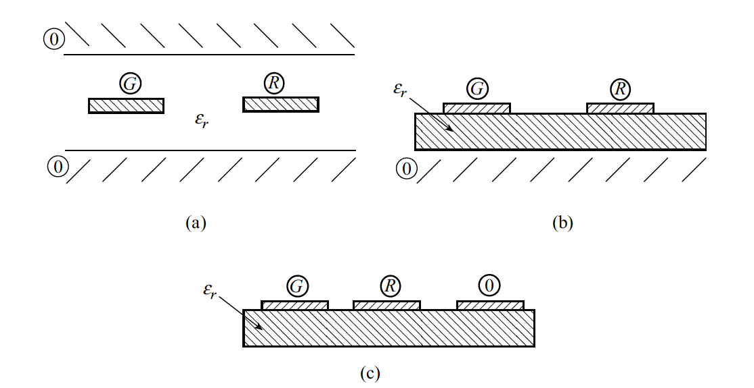
Cross Section of Typical Three-Conductor Transmission Lines Composed of PCB Lands
Coupled Stripline
Coupled Microstrip
Ordinary PCB

Slide 11
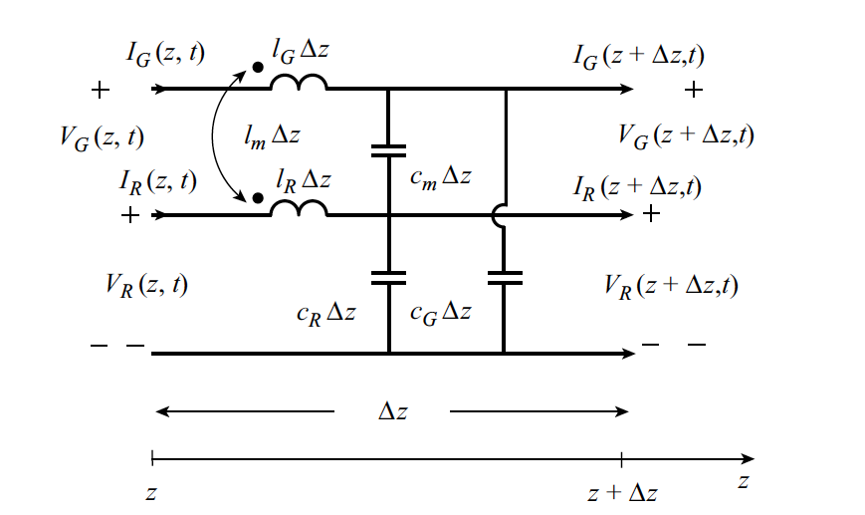
Per-Unit Length Equivalent Circuit for a 3-Conductor Transmission Line
Self-inductances
Mutual
inductance

Slide 12
Per-Unit Length Equivalent Circuit for a 3-Conductor Transmission Line
Mutual
capacitance
Self-capacitances

Slide 13
MTL Equations
Writing the Kirchhoff voltage law:
And the Kirchhoff current law:
Dividing both sides by Δz and letting Δz➔0 gives the multiconductor transmission line
(MTL) equations (see next slide)

Slide 14
MTL Equations
MTL equations:
and:
These are coupled partial differential equations. They can be written compactly in matrix form (see next slide).

Slide 15
MTL Equations
MTL equations:
where:
and:

Slide 16
MTL Equations
MTL equations:
The MTL equations can be manipulated into two uncoupled wave equations for the line voltage and current:

Slide 17
MTL Equations in the Frequency Domain
MTL equations:
The second order uncoupled wave equations for the line voltage and current become:

Slide 18
Per-Unit Length Parameters
Lines in a homogeneous medium described by a permittivity ε and a permeability μ:
where 1₂ is the 2X2 identity matrix:
and v is the velocity of propagation of TEM waves along the line:
Hence for lines in a homogeneous medium, each per-unit-length parameter matrix can be found from the other:

Slide 19
Per-Unit Length Parameters
Line Inductance and Capacitance Matrices
Assuming that the wires are widely separated and they are immersed in a homogeneous medium, we can compute the per-unit-length parameters by assuming that the currents and per-unit-length charges are distributed uniformly about the axes of the wires.
For an N-wire line, the inductance and capacitance matrices are expressed as
where F is an NxN matrix of terms depending only on the geometry of the conductors
This matrix is given in the next vugraph

Slide 20
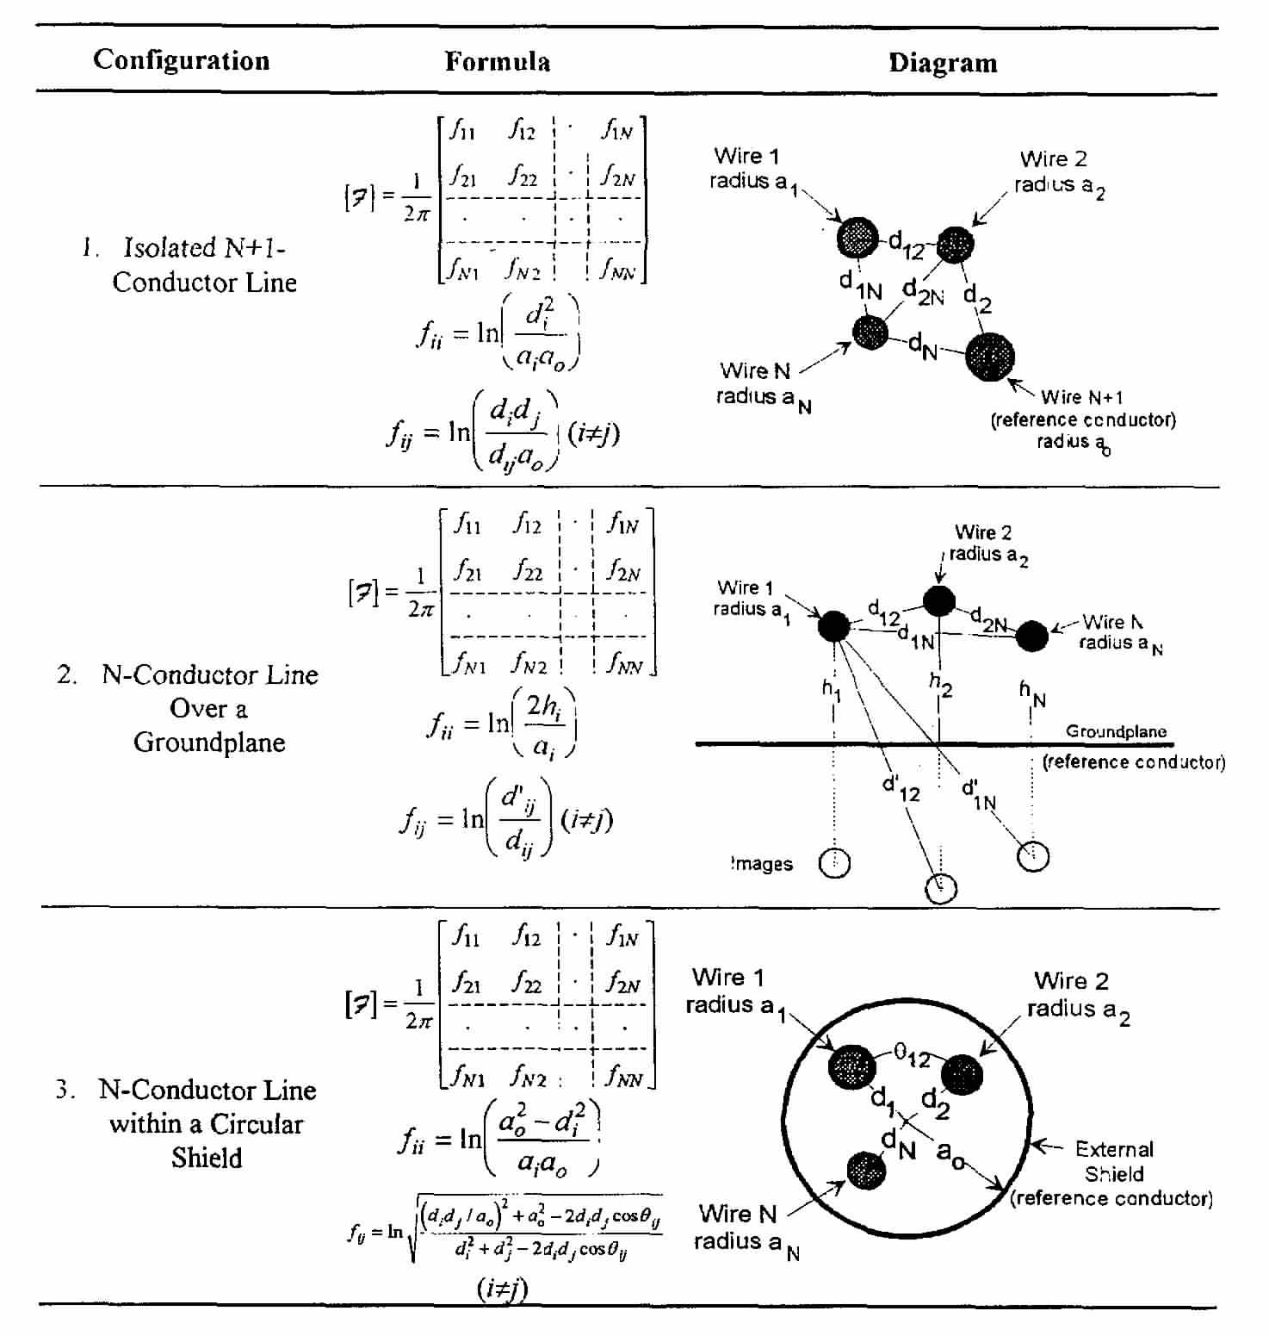
Per-Unit Length Parameters
Line Inductance Matrix
Matrix F

Slide 21
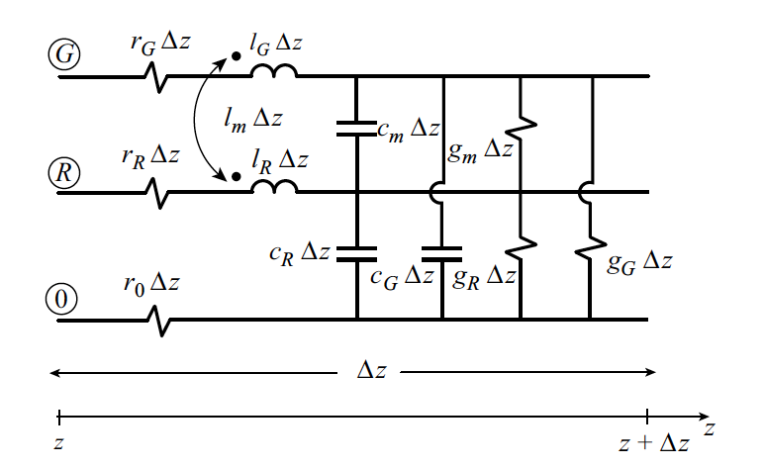
MTL Equations – Lossy Lines
Per-unit-length model of a 3-conductor lossy line:
There are two sources of line losses:
1. Resistance of the line conductors

Slide 22
MTL Equations – Lossy Lines
Per-unit-length model of a 3-conductor lossy line:
There are two sources of line losses:
2. Losses in the surrounding dielectric medium (coaxial cables or dielectric board of PCBs)

Slide 23
MTL Equations – Lossy Lines
MTL Equations
where

Slide 24
MTL Equations – Lossy Lines
MTL Equations
Uncoupled second-order MTL equations
Note that the order of matrix multiplication is important.

Slide 25
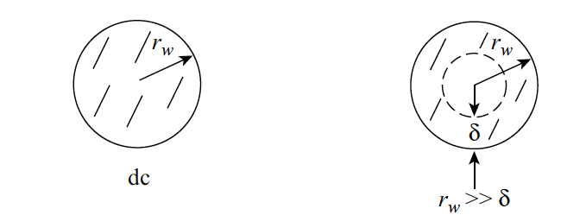
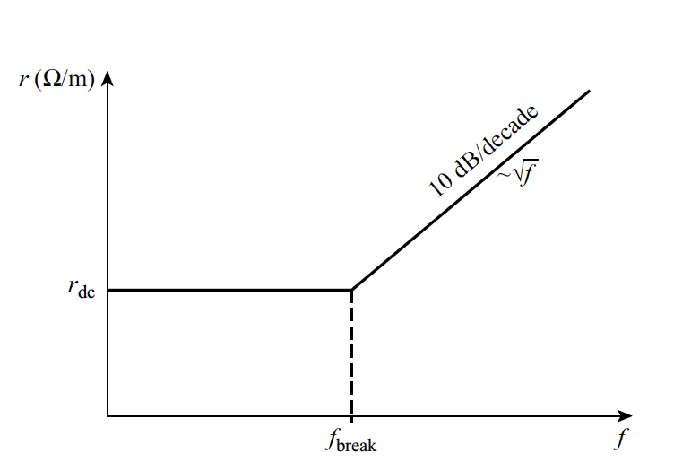
Lossy Line Parameters: Conductor Losses
Skin effect in round conductors
The internal inductance of the conductor has not been considered
Note:

Slide 26
Lossy Line Parameters: Conductor Losses
Skin effect in round conductors
Specific formulas are available for PCB lands (see C.R. Paul, Transmission Lines in Digital and Analog Electronic Systems, Wiley, 2010)
Note:

Slide 27
Lossy Line Parameters: Dielectric Losses
Dielectric losses can be modeled with a complex permittivity
the usual permittivity of the dielectric

Slide 28
Lossy Line Parameters: Dielectric Losses
Dielectric losses can be modeled with a complex permittivity
The dielectric losses are generally given at various frequencies in terms of a loss tangent defined as
The complex permittivity can be written as
And an effective conductivity of the dielectric representing the dielectric loss can be defined as
Associated with the losses of the dielectric
For typical dielectrics, the ohmic conductivity can be neglected.

Slide 29
References and Further Reading
[1] C.R. Paul, Introduction to Electromagnetic Compatibility, Second Edition, Wiley, 2006.
[2] F.M. Tesche, M. Ianoz, T. Karlsson, Emc Analysis Methods and Computational Models, Wiley, 1997.
[3] C.R. Paul, Transmission Lines in Digital and Analog Electronic Systems, Wiley, 2010.
[4] F. Rachidi, A Review of Field-to-Transmission Line Coupling Models with Special Emphasis to Lightning-Induced Voltages, IEEE Transactions on Electromagnetic Compatibility, Vol. 54, No. 4, pp. 898 - 911, 2012.

